Slide 1

使用limma、Glimma和edgeR，RNA-seq数据分析易如反掌
BioC Asia 2020 Workshop
15 Oct 2020
Instructor: Xueyi Dong

Slide 2
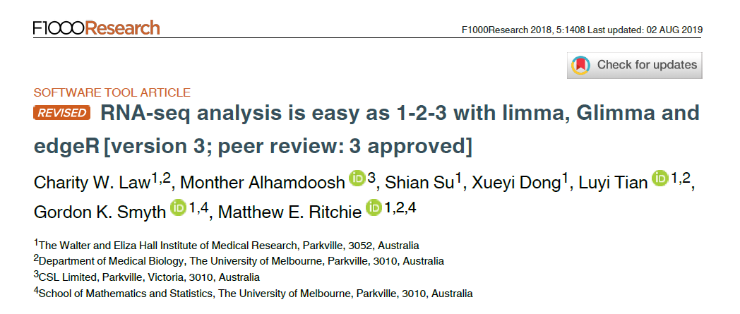
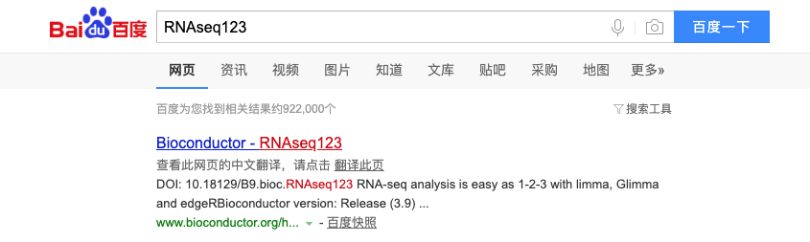

Slide 3
使用RStudio云服务器
访问 http://workshop.bioc.cancerdatasci.org/
下拉菜单选择RNA-seq 123 (Chinese)，并填写你的邮箱地址，点击“submit”
点击“Launch Workshop”，进入Rstudio登录界面
用户名: rstudio
密码: welcome-to-bioc2020

Slide 4
背景介绍
RNA-sequencing is a method to quantify the amount of RNA in a sample
Tells us which genes are active and how much they are transcribed
Measure gene expression levels
Differential expression analysis
Compare gene expression between different groups
Examples:
Compare normal cells to mutated cells
Compare treated cells to control cells

Slide 5
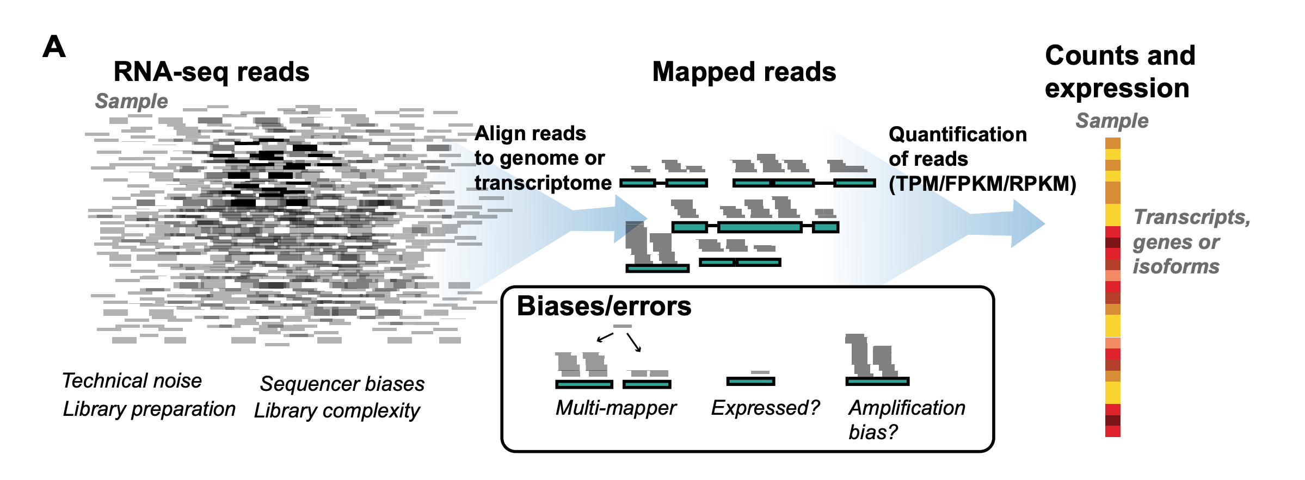
比对与计数
Ballouz et al, NAR 2018
Notes:
https://www.ncbi.nlm.nih.gov/pmc/articles/PMC6007662/

Slide 6



RNA-seq流程总览
序列片段reads – FASTQ文件
与参考基因组比对
对映射到每个基因的reads数量进行计数 (计数矩阵)
数据预处理
差异表达分析
Notes:
Can be replaced by schematic

Slide 7
Experimental design
Biological replicates!
Reference samples between different sequencing runs (if adding MORE samples and want to analyse together)
Don’t sequence all of one group on one day, and all of another group on another day! Group will be confounded with sequencing date.
Likewise for any other potential batch effects – sampling date, sequencing date, technician collecting/preparing samples.
Notes:
Credit: Charity Law

Slide 8
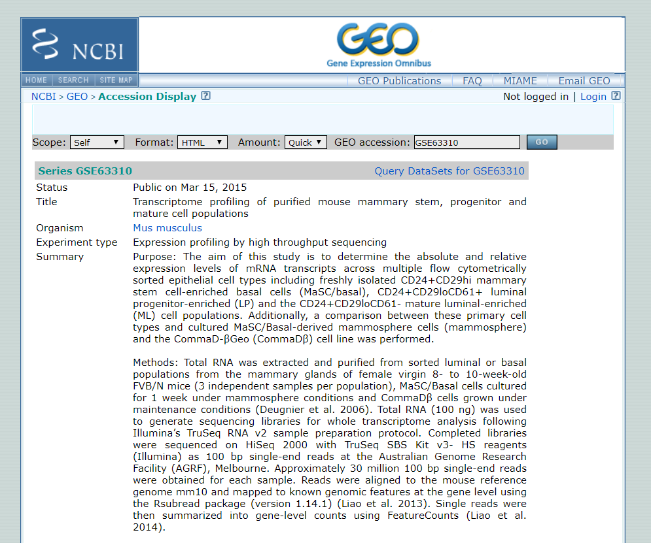
About the data
Sheridan et al. (2015)
Mouse mammary glands samples from 3 cell populations:
Basal 3 replicates
Luminal progenitor (LP) 3 replicates
Mature luminal (ML) 3 replicates
Want to compare gene expression levels between cell populations

Slide 9
Getting started
[Demo in R]
Notes:
Open Rstudio
Point out the four panes in Rstudio and mention what they are.
File > New File > R script

Slide 10
Differential expression analysis

Slide 11
limma与线性模型
linear modelling for microarrays (and RNAseq)
为设计矩阵中指定的参数估算效应，例如 条件1和条件2
每个基因的表达均不同，但相同的模型将会同时拟合于每个基因
Mean expression of Gene X
9
3
Notes:
Credit: Charity Law

Slide 12
limma与线性模型
设计矩阵（design matrix）用于指定对基因表达有影响的自变量，如实验分组、批次效应
设计矩阵可以指定有或无截距
今天将使用无截距的设计矩阵
其他不同类型的设计矩阵例子可以参照limma用户指南

Slide 13
limma与线性模型
对比（contrast）用于寻找效应之间的差异
The variability in the observations determines whether the difference is considered “significant” or not (?p-value<0.05)
Mean expression of Gene X
6
9
3
Notes:
Credit: Charity Law

Slide 14
limma与线性模型
对比（contrast）用于寻找效应之间的差异
观测值的差异性（variability）确定差异是否被认为是显着的（p值<0.05？）
Sample expression of Gene X
6
9
3
Notes:
Credit: Charity Law

Slide 15
Batch effects in intercept-free model

Slide 16
RNA-seq数据是
离散的 (counts)
具有非恒定的均值-方差趋势
voom
转换为logCPM
通过使用基因权重值消除均值-方差趋势
✔
可以假设数据服从正态分布
连续的
具有恒定的方差
Notes:
Credit: Charity Law
Let me show you what the mean-var dependence looks like …

Slide 17
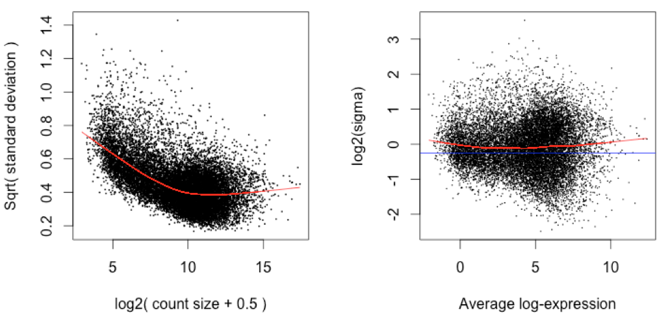
voom: variance weights
Use mean-var trend to assign weights to each observation
Weights used in linear modelling removes mean-variance trend from the data.
Before: trended variance
After: constant variance
Qtr-root variance
Log2- variance
Mean log-count
Mean log-cpm
Notes:
Credit: Charity Law

Slide 18
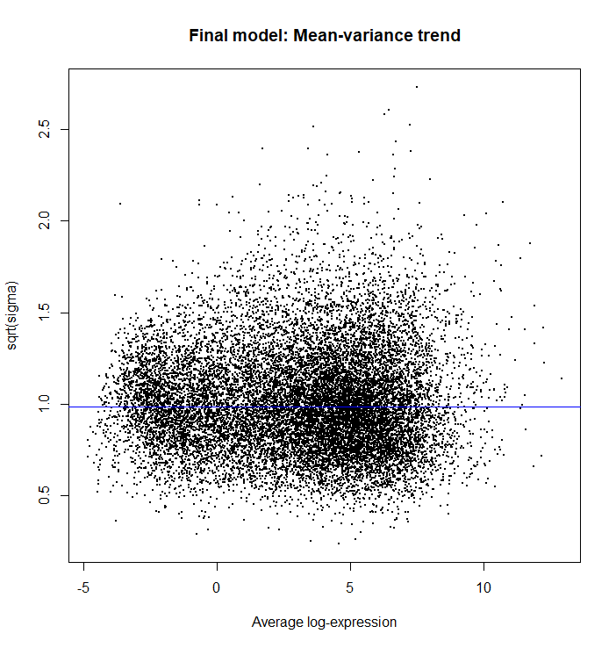
Fit linear models
Fits a linear model for each gene
Computes statistics and fold changes for comparisons of interest
> vfit <- lmFit(v, design)
> vfit <- contrasts.fit(vfit, contrasts=contr.matrix)
> efit <- eBayes(vfit)
> plotSA(efit, main="Final model: Mean-variance trend")
Computes more precise estimates by sharing gene information using empirical Bayes moderation
Plots residual standard deviation versus average log expression for fitted model

Slide 19
Sharing gene information
Experiments have small sample sizes due to sequencing cost and/or availability of samples and RNA.
Estimated variability within an individual gene is unreliable (statistically inefficient) $→$ pooling information from all genes (increases statistical power)
Empirical Bayes method: borrow information from all data to form prior information that is used to adjust observed values to values that are more precise.
In limma, a posterior variance is calculated by squeezing observed variances towards the prior variance. The posterior variance is given by
Moderated t-statistic is calculated using the posterior variance.
$$S2g=\frac{d0s20+dgs2g}{d0+dg}$$
Notes:
Credit: Charity Law
$s20$ is the prior variance
$s2g$ is the observed variance

Slide 20
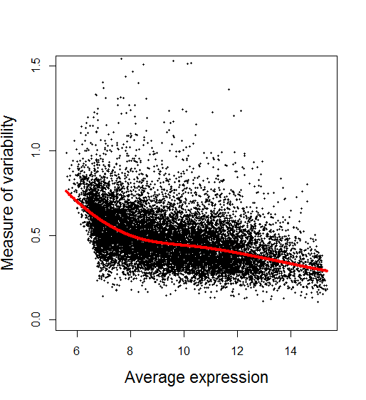
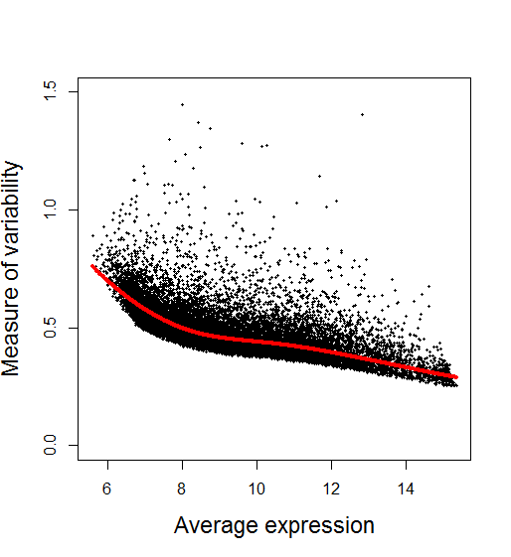
使用经验贝叶斯调整前后的差异性
Before After
Slide from COMBINE workshop (edited)
Notes:
Credit: Charity Law

